Slide 1

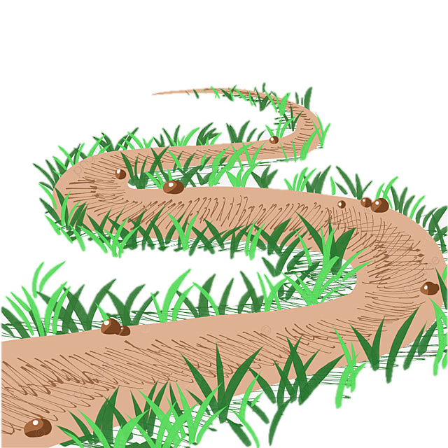


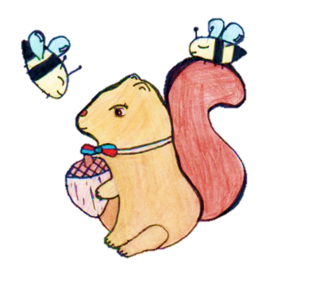
St Antony’s Geography Learning Journey
Nursery
Traditional tales / Under the sea
All about me
Superheroes
Growing
Reception
Animals – dinosaur s/ Next step -transport/
Ourselves and families
How do I get to school?
Year 1
Food / People who help us
What is the weather like in the UK?
What places are there in the UK?
Year 2
How can we look after our woodlands?
What is wonderful about our world?
What is like in Australia?
Year 3
What is happening in our oceans?
What is it like to live in a village?
How can people live in a desert?
Year 4
What is it like to live in a rainforest?
How does water go round and round?
Why do people leave their home?
Year 5
Would you like to visit Italy?
Year 6
Why is our world so different?
Where do all our things come from?
Who wants to be in America?
What can we do about climate change?
How does the earth shake, rattle and roll?

