Slide 1

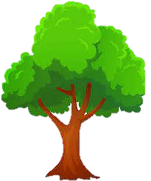
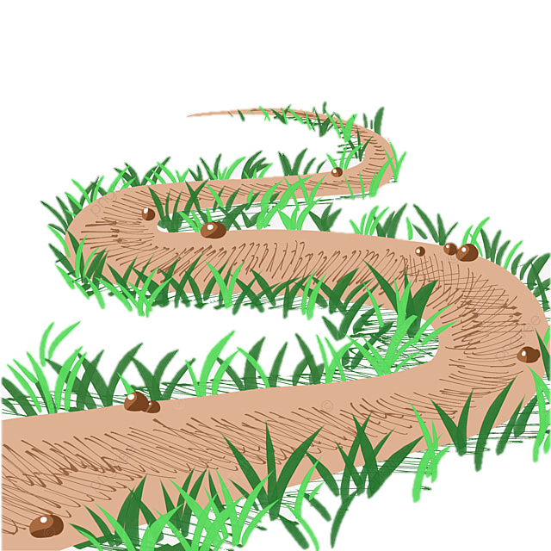


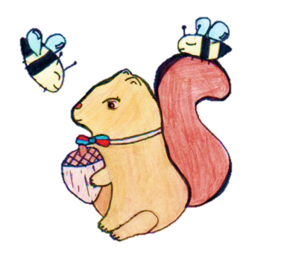
St Antony’s DT Learning Journey
All About Me
People Who Help Us
Growing
Clothes
Toys
Reception
Boats
Nursery
Junk modelling
Year 2
Cooking and nutrition -
smoothies
Mechanisms-
Moving story book
Textiles-
Puppets
Year 1
Book marks
Mechanisms – Wheels & axles 1
Textiles – cross stitch & Applique
Cooking and nutrition-eating seasonally
Year 4
Balanced diet- Teddy Bears’ Picnic
Year 3
Paper Structures
Structure – Bridges
Structures-
Pavilions
Electrical systems-Torches
Cooking and nutrition-developing a recipe
Food and nutrition –adapting a recipe
Mechanisms-pop- up books
Structures
What does an architect do?
Year 6
Year 5
Structures- bridges
Textiles -Fastenings
Advertising using computer

